Slide 1
FIRE SAFETY FOR KIDS
Anita Devi Avikash Nand

Slide 2
Use Case
When the player wants to play the game must read the instruction.
He can then start the game by clicking on the play icon.
If he is able to get answer then he can proceed to the next question.
If he gets the wrong answer then he can try again.
If he completes one round then he get the next round of questions from the question bank.

Slide 3
The Administrator creates questions and stores in question bank. For every round the player will get reshuffled questions.

Slide 4
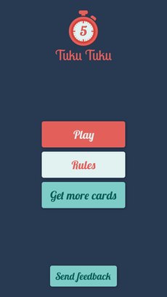
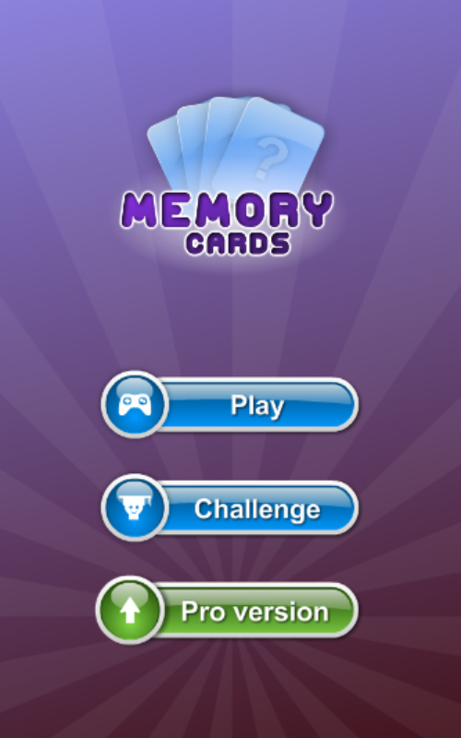
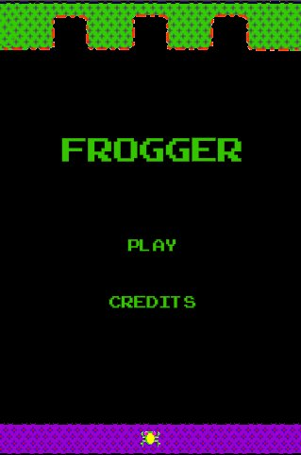
Design research
We looked at a lot of different main screen ideas for our app and came across these 3 which we thought looked nice and simple. All of these apps have a simple looking GUI with minimal colours used and only 2 or 3 buttons. By looking at these designs we thought of using only 2 buttons in the main screen
(Play button & Instructions button).We also thought of adding a picture in the Main Gui so that it doesn’t look dull & boring when kids open the app.

Slide 5



Game Interface
This will the main interface of our game.
The player needs to click on the play icon to get the instructions of the game.
After that the player can proceed with game.

Slide 6
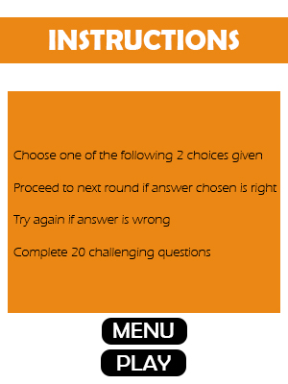
Game Interface
The player needs to know the instruction before playing the game.

Slide 7
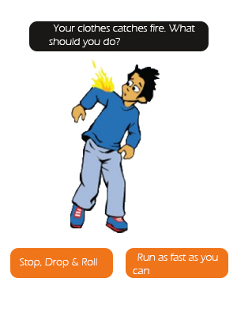
There will be 20 set of questions. Each Questions will have one right answer and one wrong answer. There will be pictures and sound in every question so that kids don’t get bored by only reading it.

Slide 8
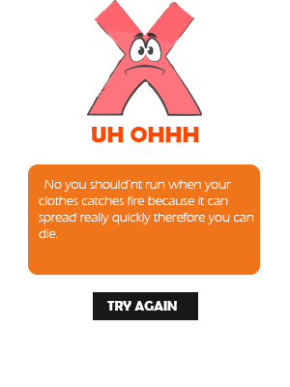
When the player clicks on the wrong answer a “uh ohhh”
sound will appear and he will have to try again.

Slide 9
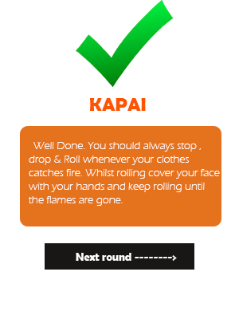
When the player clicks on the right answer he will get a wow sound.

Slide 10

Issues we faced
Other Assignments – We had other class assignments to do which interfered with the assignment we are doing now. It was pretty hard to manage 2 assignments at once because both are big assignments, and also due on the same date.
Work – Both of us had work on some days meaning we didn’t get much time to do our assignments after work and Anita had to do housework such as cooking and other house chores which made it a challenge for her to do multiple tasks.
Getting used to Android Studio – It was difficult to get used to Android studio to develop the game because it was new to us and we had a short amount of time to make a fully functional game. With the help of YouTube & google we were able to make a good progress on making the game.

Slide 11
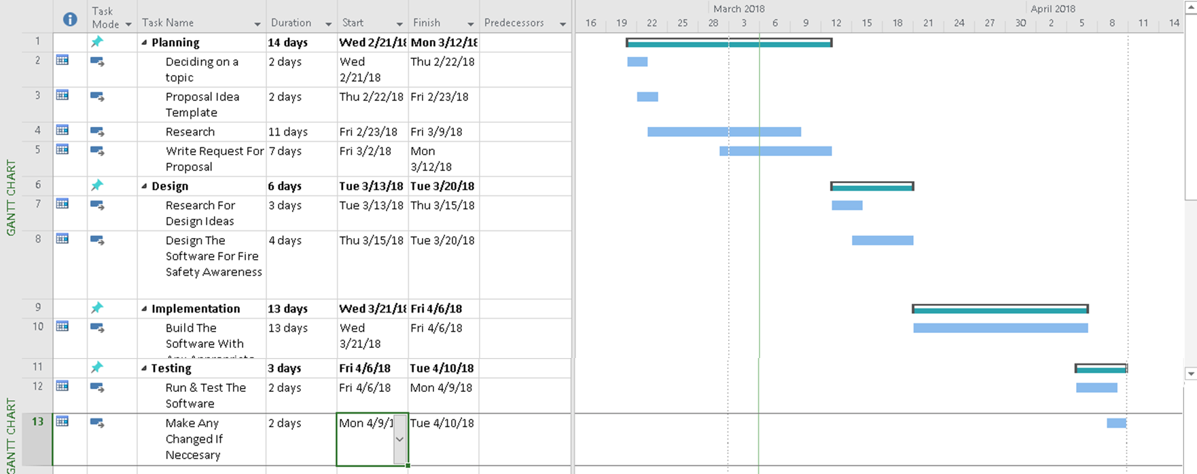
Gantt chart
Currently everything is going well according to our Gantt chart. We have finished the planning & the design phase. Now we are currently in the Implementation Phase of the project. We plan to get the game finished by the 6th of April according to our plan. Then later we can do some testing to see if there's any bugs and if it needs any necessary changes.

Slide 12


Thank you

Slide 13
References
August 15 2015 ISSUES Retrieved from https://www.facebook.com/ISSUESSHOP/photos/a.433273299797.234420.97552074797/10153512005804798/?type=1&theater Hedfones (27 January 2008). File:Happy smiley face.png Retrieved from https://commons.wikimedia.org/wiki/File:Happy_smiley_face.png (N.D) Tuku Tuku Retrieved from http://www.broccoligames.com/ gilamran (N.D) simple-layout-js Basic Tutorial Retrieved from http://gilamran.github.io/simple-layout-basic-tutorial/ Skiptis (February 18, 2017). Simple Game Menu Background Corona Sdk Build A Frogger Inspired Game Interface Creation Retrieved from http://80skiparty.com/game-menu-background/simple-game-menu-background-corona-sdk-build-a-frogger-inspired-game-interface-creation/

